Slide 1
Inheritance Using JPA and XML

Slide 2
Intro
Inheritance is one of the most visible facets of Object-relational mismatch. Object oriented systems can model both “is a” and “has a” relationship. Relational model supports only “has a” relationship between two entities. Hibernate can help you map such Objects with relational tables. But you need to choose certain mapping strategy based on your needs.

Slide 3
Inheritance Mapping Strategies
Hibernate supports 3 types of Inheritance Mappings:
Table per class hierarchy
Table per sub-class hierarchy
Table per concrete class hierarchy

Slide 4
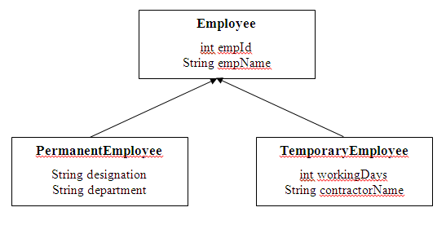
Example for Mapping

Slide 5
Why Mapping is required
how many tables are required
how to link the tables so that PermanentEmployee gets four properties of empIdand empName (from super class), designation and department.

Slide 6
The three approaches adopted by Hibernate
table-per-class-hierarchy: Only one table is created for all the classes involved in hierarchy. Here we maintain an extra discriminator field in table to differentiate between PermanentEmployee and TemporaryEmployee.
table-per-subclass: One table for each class is created. The above hierarchy gets three tables. Here, foreign key is maintained between the tables.
table-per-concrete-class: One table for each concrete class (subclass) is created but not of super class. The above hierarchy gets two tables. As a special case, the super class can be an abstract or interface. Here, foreign key is not maintained.

Slide 7
Implementing inheritance using JPA
@DiscriminatorColumn – Is used to define the discriminator column for the SINGLE_TABLE and JOINED inheritance mapping strategies. The strategy and the discriminator column are only specified in the root of an entity class hierarchy or sub hierarchy in which a different inheritance strategy is applied
If the @DiscriminatorColumn annotation is missing, and a discriminator column is required, the name of the discriminator column defaults to “DTYPE” and the discriminator type to DiscriminatorType.STRING.

Slide 8
Table Per Class Hierarchy
only one table is created with sufficient columns to accommodate all the properties of each class involved in hierarchy. Because all the records of each class are available in a single table, to differentiate which record belongs to which class.
we create one extra column known as discriminator column. Each class identified by some name (say, alias name written in the mapping file) and this name is stored in the discriminator column.

Slide 9
Table Per Class Hierarchy XML
<class name="Employee" table="EMPTABLE">
<id name="empId" column="EMP_ID" />
<discriminator column="DIS" type="string" length="3"/>
<property name="empName" column="EMP_NAME" length="8"/>
<subclass name="PermanentEmployee" discriminator-value="PE">
<property name="designation" column="DESIGNATION" length="11" />
<property name="department" column="DEPARTMENT" length="11" />
</subclass>
<subclass name="TemporaryEmployee" discriminator-value="TE">
<property name="workingDays" column="WORKING_DAYS" />
<property name="contractorName" column="CONTRACTOR_NAME" length="18" />
</subclass>
</class>

Slide 10
Table Per Class Hierarchy JPA
@Entity @Table(name = “Employee")
@Inheritance(strategy=InheritanceType.SINGLE_TABLE)
@DiscriminatorColumn
( name="discriminator", discriminatorType=DiscriminatorType.STRING )
@DiscriminatorValue(value="PE")

Slide 11
Table Per Subclass Hierarchy
In this Table Per Subclass style, three tables are created one for each Java program. Here, foreign key is maintained between the tables.
The three tables ETABLE (for Employee), PETABLE (for PermanentEmployee) and TETABLE (for TemporaryEmployee) do not exist.

Slide 12
Table Per Subclass Hierarchy XML
<class name="Employee" table="ETABLE" dynamic-update="true" >
<id name="empId" type="short">
<generator class="assigned" />
</id>
<property name="empName" type="string" length="10"/>
<joined-subclass name="PermanentEmployee" table="PETABLE" dynamic-update="true">
<key column="PID"/>
<property name="designation" length="10"/>
<property name="department" length="10"/>
</joined-subclass>
<joined-subclass name="TemporaryEmployee" table="TETABLE" dynamic-update="true">
<key column="TID"/>
<property name="workingDays" type="short"/>
<property name="contractorName" type="string" length="10"/>
</joined-subclass>
</class>

Slide 13
Table Per Subclass Hierarchy XML
<key> element always represents a foreign key always in mapping table. It means that column PID of permanent employee is the foreign key of the primary key empId of Employee (<id name="empId" type="short">). This is the way how Hibernate reads the mapping file. Similarly with <key column="TID"/> also.
Three tables are required. The two subclass tables have foreign key associations (<key column="PID" />) to the super class table and we can say the relational model is actually a one-to-one association.

Slide 14
Table Per Subclass Hierarchy JPA
@Entity @Table(name = “Employee")
@Inheritance(strategy=InheritanceType.JOINED)
// Second Bean Class
@PrimaryKeyJoinColumn(name=“EmployEE_ID")

Slide 15
Table-per-concrete class Hierarchy
Table Per Concreteclass style, two tables for each subclass are created. The super class variables are placed in each subclass. Observe the screenshots at the end of the notes.
The three tables of Table-per-subclass do not exist. Here tables change (only two tablesexist).

Slide 16
Table-per-concrete class XML
<hibernate-mapping>
<class name="Employee">
<id name="empId">
<generator class="assigned"/>
</id>
<property name="empName" length="8"/>
<union-subclass name="PermanentEmployee" table="PETABLE1">
<property name="designation" length="10" />
<property name="department" length="10" />
</union-subclass>
<union-subclass name="TemporaryEmployee" table="TETABLE1">
<property name="workingDays" type="short" />
<property name="contractorName" length="10" />
</union-subclass>
</class>

Slide 17
Table-per-concrete class JPA
@Entity @Table(name = “Employee")
@Inheritance(strategy = InheritanceType.TABLE_PER_CLASS)
// Second Bean
@Entity @Table(name="EMPLOYEE")
@AttributeOverrides({ @AttributeOverride(name="firstname", column=@Column(name="FIRSTNAME")), @AttributeOverride(name="lastname", column=@Column(name="LASTNAME")) }) public class Employee extends Person

Slide 18
Fetch in Mapping
From the JPA 2.1 spec, the defaults are like so:
OneToMany:LAZY
ManyToOne: EAGER
ManyToMany: LAZY
OneToOne: EAGER
Columns : EAGER

Slide 19
Hibernate Relational Associations
Two important features of Hibernate are Inheritance (Hierarchical) Mapping (supported by table-per-subclass etc.) and Relational Associations (supported by one-to-many etc.) The first one is discussed earlier and now let us go for the second one.
In database terminology, an association denotes a relationship between two tables. This tutorial explains the way how Hibernate writes Java bean classes to implement this relation

Slide 20
4 associations Hibernate supports
The associations may be unidirectional or bidirectional.
The 4 associations Hibernate supports are
1. One to One 2. One to Many 3. Many to One 4. Many to Many

Slide 21
One-to-One Example Hibernate
One-To-one Relationship: In one-to-one relationship, one record in one table is related to exactly to one record in another table. The two tables are associated with a foreign key. That is, the primary key of one table is the foreign key in another table.
Concept: One Student contains only one residential address. Here, Student class maps to studentinfo table and Address class maps to addressinfo table.
Association in tables: sid exists in both the tables. sid is declared as primary key in studentinfo table and the same sid is declared as foreign key in addressinfo table. That is, sid exists in both the tables.
Bean coding: Two beans exist, Student and Address. As Student have one to one relationship with Address and as well Address have one to one relationship with Student, one object of Address is created in Student class and also one object of Student is created in Address class.

Slide 22
<many-to-one> XML element is used to establish the many-to-one relationship between the Dept and Employee classes.
cascade="all"
The cascade attribute does the required operations to the associated Java class. all value set to cascade element, cascades all the operations. For example, if you save the Employeeobject, the corresponding Dept object also will be saved automatically.

Slide 23
Association in tables: studentId and courseId are the primary keys in studentinfo and courseinfo tables. studentId is the foreign key, in courseinfo, associated with courseId. Similarly, courseId is the foreign key, in studentinfo, associated with studentId. This mapping is done with <key> element in mapping table. <key> represents always a foreign key in a database table.
Bean coding: Two beans exist, Student and Course. A Set is created in Student class to which all the courses attended by the student are added. Similarly, another Set is created in Course class to which all the students attending the course are added. Here, Set is preferred to List for the reason one student does not go to the same course twice and similarly one course does not have the same student twice. Instead of Set, List also can be used where applicable in other cases. But one thing must be clear, in many-to-many association, it is a must to use a collection class on both the sides

Slide 24
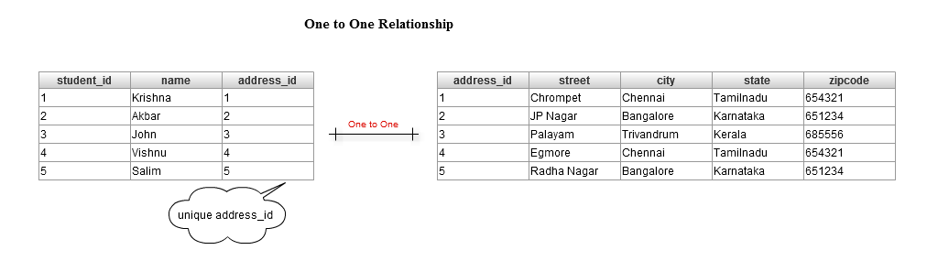
One to One Mapping

Slide 25
One to One Mapping XML & JPA
A unidirectional one-to-one association uses the relationship student and address
XML :
<one-to-one name="address“
class=“xml.Address“ cascade="all" />
JPA:
@OneToOne(cascade = CascadeType.ALL)

Slide 26
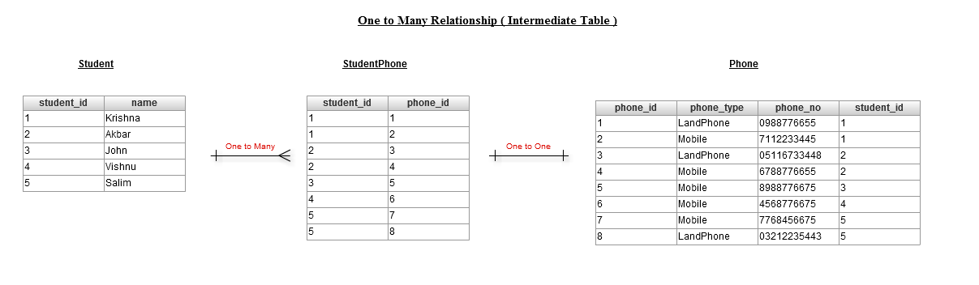
One to Many Mapping

Slide 27
One to Many XML
A unidirectional One-to-many association on a foreign key is an unusual case, and is not recommended. Consider referring One to Many using Joins
<set name="studentPhone" cascade="all">
<key column="stud_id" />
<one-to-many class=“xml.Phone" />
</set>

Slide 28
One to Many JPA
One-to-many associations are declared at the property level with the annotation @OneToMany. One to many associations may be bidirectional.
A unidirectional one to many with join table is much preferred. This association is described through and @JoinTable.
@JoinColumn is used to specify a mapped column for joining an entity association.
@OneToMany(cascade = CascadeType.ALL)
@JoinTable(name = "STUDENT_PHONE", joinColumns = { @JoinColumn(name = "STUDENT_ID") }, inverseJoinColumns = { @JoinColumn(name = "PHONE_ID") })

Slide 29
Many to One Mapping XML & JPA
A unidirectional many-to-one association is the most common kind of unidirectional association.
XML :
<many-to-one name="studentAddress" class=“xml.Address“ column="STUDENT_ADDRESS" cascade="all" />
JPA :
@ManyToOne(cascade = CascadeType.ALL)

Slide 30
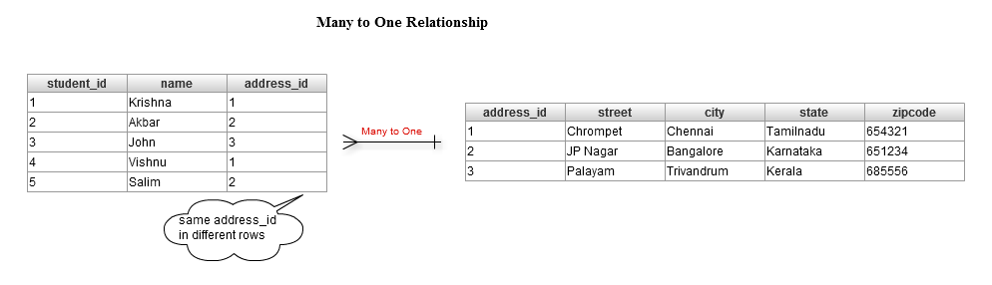
Many to One Mapping

Slide 31
Many-to-Many Hibernate
There are two styles to maintain association in many-to-many Hibernate – a) using Set and b) using Map.
Many-To-many Relationship: In many-to-many relationship, as the name implies, many records of one table are associated with many records of another table.
Concept: One Student may attend multiple courses and similarly one course may be attended by multiple students. You can say, it is many-to-many as multiple students vs multiple courses. Infact, it is one-to-many relationship. Each record (of a group of multiple records) of one table is associated with multiple records of another table.
.

Slide 32
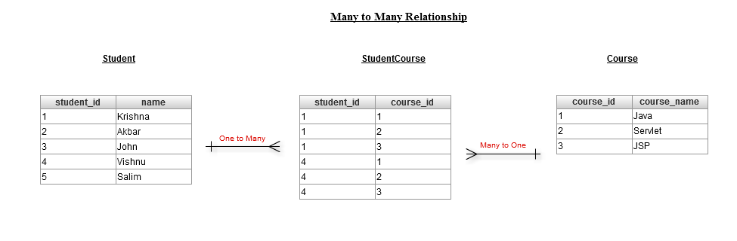
Many to Many Mapping

Slide 33
Many to Many Mapping XML based
A unidirectional Many-to-many association mappings need 3 tables, the intermediate table contains primary key of both the entity. But Many to Many is not recommended since most of the use case the intermediate need to maintain some extra data like created by etc..
<set name="courses" table="SCOURSE" cascade="all">
<key column="SID" />
<many-to-many column="CID“ class=“xml.Course" />
</set>

Slide 34
Many to Many Mapping JPA
A many-to-many association is defined logically using the @ManyToMany annotation. You also have to describe the association table and the join conditions using the @JoinTable annotation.
@ManyToMany(cascade = CascadeType.ALL)
@JoinTable(name = "STUDENT_COURSE", joinColumns = { @JoinColumn(name = "STUDENT_ID") }, inverseJoinColumns = { @JoinColumn(name = "COURSE_ID") })

Slide 35
Cascade Attribute
Hibernate relations is to getting the relation between parent and child class objects
Cascade attribute is mandatory, when ever we apply relationship between objects, cascade attribute transfers operations done on one object onto its related child objects
If we write cascade = “all” then changes at parent class object will be effected to child class object too

Slide 36
CascadeType.ALL : is shorthand for all of the above cascade operations.
Cascade. orphanRemoval = true
cascade =”all-delete-orphan”

Slide 37
Example
@OneToMany(cascade=CascadeType.ALL)
@JoinTable(name="user_roles",joinColumns=
{@JoinColumn(name="role_id",
referencedColumnName="id")},
inverseJoinColumns=
{@JoinColumn(name="user_id", referencedColumnName="id")
})

Slide 38
Mapped By property
XML :
@OneToMany(mappedBy=“fieldname")

